Slide 1
Descriptive Statistics

Slide 2
Descriptive Statistics
Descriptive Statistics are Used by Researchers to Report on Populations and Samples
By Summarizing Information, Descriptive Statistics Speed Up and Simplify Comprehension of a Group’s Characteristics

Slide 3
Sample vs. Population
Population
Sample

Slide 4
Descriptive Statistics
An Illustration:
Which Group is Smarter?
Class A--IQs of 13 Students
102 115
128 109
131 89
98 106
140 119
93 97
110
Class B--IQs of 13 Students
127 162
131 103
96 111
80 109
93 87
120 105
109
Each individual may be different. If you try to understand a group by remembering the qualities of each member, you become overwhelmed and fail to understand the group.

Slide 5
Descriptive Statistics
Which group is smarter now?
Class A--Average IQ Class B--Average IQ
110.54 110.23
They’re roughly the same!
With a summary descriptive statistic, it is much easier to answer our question.

Slide 6
Descriptive Statistics
Types of descriptive statistics:
Organize Data
  Tables
  Graphs
Summarize Data
  Central Tendency
  Variation

Slide 7
Descriptive Statistics
Types of descriptive statistics:
Organize Data
  Tables
    Frequency Distributions
    Relative Frequency Distributions
  Graphs
    Bar Chart or Histogram
    Stem and Leaf Plot
    Frequency Polygon

Slide 8
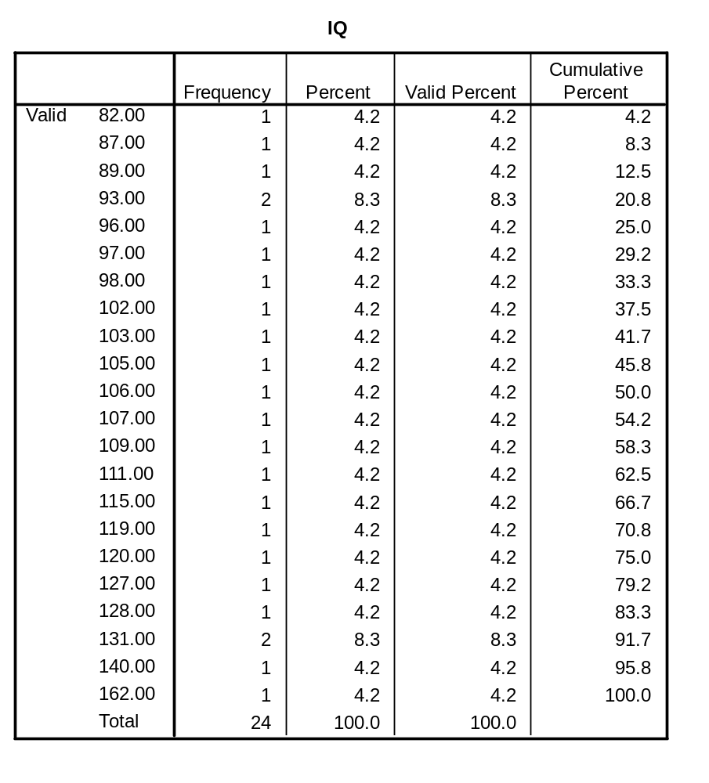


Slide 9
Frequency Distribution
Frequency Distribution of IQ for Two Classes
IQ Frequency
82.00 1
87.00 1
89.00 1
93.00 2
96.00 1
97.00 1
98.00 1
102.00 1
103.00 1
105.00 1
106.00 1
107.00 1
109.00 1
111.00 1
115.00 1
119.00 1
120.00 1
127.00 1
128.00 1
131.00 2
140.00 1
162.00 1
Total 24

Slide 10
Relative Frequency Distribution
Relative Frequency Distribution of IQ for Two Classes
IQ Frequency Percent Valid Percent Cumulative Percent
82.00 1 4.2 4.2 4.2
87.00 1 4.2 4.2 8.3
89.00 1 4.2 4.2 12.5
93.00 2 8.3 8.3 20.8
96.00 1 4.2 4.2 25.0
97.00 1 4.2 4.2 29.2
98.00 1 4.2 4.2 33.3
102.00 1 4.2 4.2 37.5
103.00 1 4.2 4.2 41.7
105.00 1 4.2 4.2 45.8
106.00 1 4.2 4.2 50.0
107.00 1 4.2 4.2 54.2
109.00 1 4.2 4.2 58.3
111.00 1 4.2 4.2 62.5
115.00 1 4.2 4.2 66.7
119.00 1 4.2 4.2 70.8
120.00 1 4.2 4.2 75.0
127.00 1 4.2 4.2 79.2
128.00 1 4.2 4.2 83.3
131.00 2 8.3 8.3 91.7
140.00 1 4.2 4.2 95.8
162.00 1 4.2 4.2 100.0
Total 24 100.0 100.0

Slide 11
Grouped Relative Frequency Distribution
Relative Frequency Distribution of IQ for Two Classes
IQ Frequency Percent Cumulative Percent
80 – 89 3 12.5 12.5
90 – 99 5 20.8 33.3
100 – 109 6 25.0 58.3
110 – 119 3 12.5 70.8
120 – 129 3 12.5 83.3
130 – 139 2 8.3 91.6
140 – 149 1 4.2 95.8
150 and over 1 4.2 100.0
Total 24 100.0 100.0

Slide 12
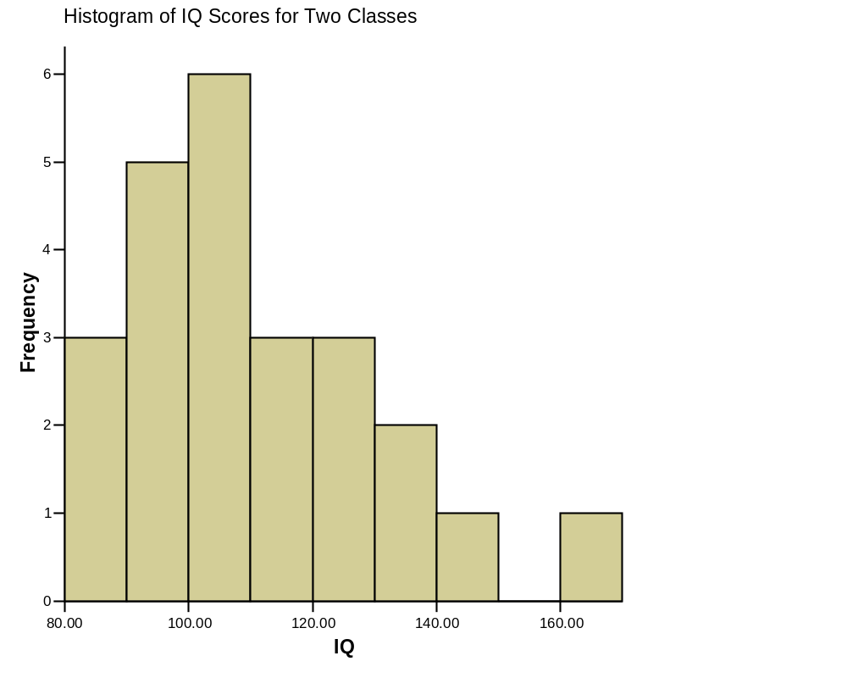


Histogram

Slide 13
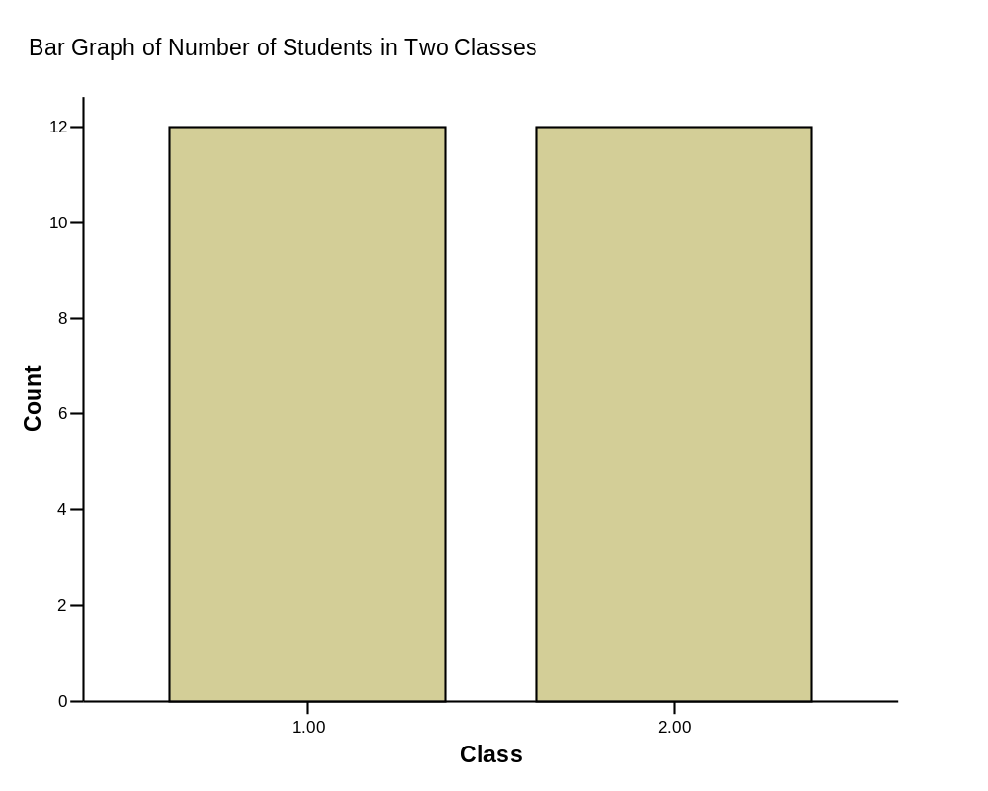

Bar Graph

Slide 14
Descriptive Statistics
Summarizing Data:
  Central Tendency (or Groups’ “Middle Values”)
    Mean
    Median
    Mode
  Variation (or Summary of Differences Within Groups)
    Range
    Interquartile Range
    Variance
    Standard Deviation

Slide 15
Mean
Most commonly called the “average.”
Add up the values for each case and divide by the total number of cases.
Y-bar = (Y1 + Y2 + . . . + Yn)
n
Y-bar = Σ Yi
n

Slide 16

Mean
What’s up with all those symbols, man?
Y-bar = (Y1 + Y2 + . . . + Yn)
n
Y-bar = Σ Yi
n
Some Symbolic Conventions in this Class:
Y = your variable (could be X or Q or ☺ or even “Glitter”)
“-bar” or line over symbol of your variable = mean of that variable
Y1 = first case’s value on variable Y
“. . .” = ellipsis = continue sequentially
Yn = last case’s value on variable Y
n = number of cases in your sample
Σ = Greek letter “sigma” = sum or add up what follows
i = a typical case or each case in the sample (1 through n)

Slide 17
Mean
Class A--IQs of 13 Students
102 115
128 109
131 89
98 106
140 119
93 97
110
Class B--IQs of 13 Students
127 162
131 103
96 111
80 109
93 87
120 105
109
Σ Yi = 1437 Σ Yi = 1433
Y-bar_{A} = Σ Yi = 1437 = 110.54 Y-bar_{B} = Σ Yi = 1433 = 110.23
n 13 n 13

Slide 18
Mean
Means can be badly affected by outliers (data points with extreme values unlike the rest)
Outliers can make the mean a bad measure of central tendency or common experience
Income in the U.S.
Bill Gates
All of Us
Mean
Outlier

Slide 19
Median
The middle value when a variable’s values are ranked in order; the point that divides a distribution into two equal halves.
When data are listed in order, the median is the point at which 50% of the cases are above and 50% below it.
The 50th percentile.

Slide 20
Median
Class A--IQs of 13 Students
89
93
97
98
102
106
109
110
115
119
128
131 140
Median = 109
(six cases above, six below)

Slide 21
Median
If the first student were to drop out of Class A, there would be a new median:
89
93
97
98
102
106
109
110
115
119
128
131
140
Median = 109.5
109 + 110 = 219/2 = 109.5
(five cases above, five below)

Slide 22
Median
The median is unaffected by outliers, making it a better measure of central tendency, better describing the “typical person” than the mean when data are skewed.
All of Us
Bill Gates
outlier

Slide 23
Median
If the recorded values for a variable form a symmetric distribution, the median and mean are identical.
In skewed data, the mean lies further toward the skew than the median.
Symmetric
Skewed
Mean
Mean
Median
Median

Slide 24
Median
The middle score or measurement in a set of ranked scores or measurements; the point that divides a distribution into two equal halves.
Data are listed in order—the median is the point at which 50% of the cases are above and 50% below.
The 50th percentile.

Slide 25
Mode
The most common data point is called the mode.
The combined IQ scores for Classes A & B:
80 87 89 93 93 96 97 98 102 103 105 106 109 109 109 110 111 115 119 120
127 128 131 131 140 162
BTW, It is possible to have more than one mode!
A la mode!!

Slide 26
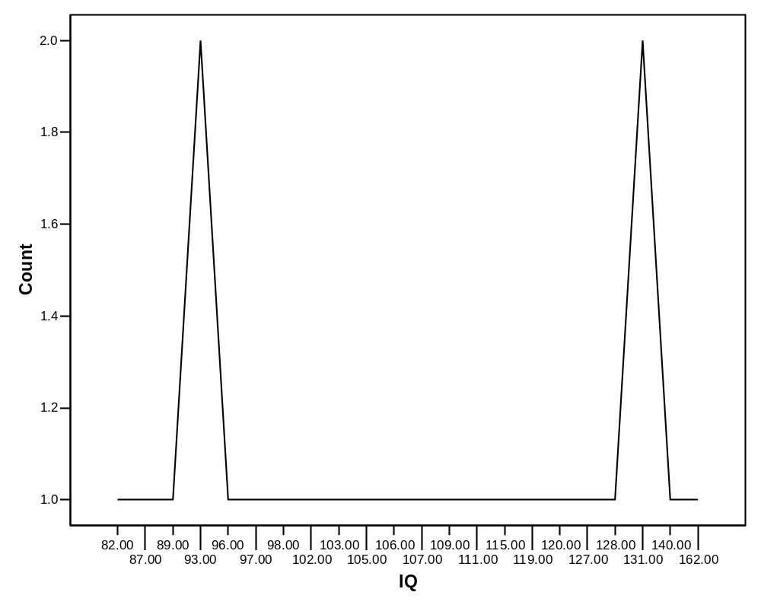
Mode
It may not be at the center of a distribution.

Slide 27
Mode
It may give you the most likely experience rather than the “typical” or “central” experience.
In symmetric distributions, the mean, median, and mode are the same.
In skewed data, the mean and median lie further toward the skew than the mode.
Symmetric
Skewed
Mean
Median
Mode
Mode
Median
Mean

Slide 28
Descriptive Statistics
Summarizing Data:
  Central Tendency (or Groups’ “Middle Values”)
    Mean
    Median
    Mode
  Variation (or Summary of Differences Within Groups)
    Range
    Interquartile Range
    Variance
    Standard Deviation

Slide 29
Range
The spread, or the distance, between the lowest and highest values of a variable.
To get the range for a variable, you subtract its lowest value from its highest value.
Class A--IQs of 13 Students
102 115
128 109
131 89
98 106
140 119
93 97
110
Class A Range = 140 - 89 = 51
Class B--IQs of 13 Students
127 162
131 103
96 111
80 109
93 87
120 105
109
Class B Range = 162 - 80 = 82

Slide 30
Interquartile Range
A quartile is the value that marks one of the divisions that breaks a series of values into four equal parts.
The median is a quartile and divides the cases in half.
25th percentile is a quartile that divides the first ¼ of cases from the latter ¾.
75th percentile is a quartile that divides the first ¾ of cases from the latter ¼.
The interquartile range is the distance or range between the 25th percentile and the 75th percentile. Below, what is the interquartile range?
25%
25%
25% of cases
25% of cases
0 250 500 750 1000

Slide 31
Variance
A measure of the spread of the recorded values on a variable. A measure of dispersion.
The larger the variance, the further the individual cases are from the mean.
The smaller the variance, the closer the individual scores are to the mean.
Mean
Mean

Slide 32
Variance
Variance is a number that at first seems complex to calculate.
Calculating variance starts with a “deviation.”
A deviation is the distance away from the mean of a case’s score.
Yi – Y-bar
If the average person’s car costs $20,000, my deviation from the mean is - $14,000!
6K - 20K = -14K

Slide 33
Variance
The deviation of 102 from 110.54 is? Deviation of 115?
Class A--IQs of 13 Students
102 115
128 109
131 89
98 106
140 119
93 97
110
Y-bar_{A} = 110.54

Slide 34
Variance
The deviation of 102 from 110.54 is? Deviation of 115?
102 - 110.54 = -8.54 115 - 110.54 = 4.46
Class A--IQs of 13 Students
102 115
128 109
131 89
98 106
140 119
93 97
110
Y-bar_{A} = 110.54

Slide 35
Variance
We want to add these to get total deviations, but if we were to do that, we would get zero every time.
We need a way to eliminate negative signs.
Squaring the deviations will eliminate negative signs...
A Deviation Squared: (Yi – Y-bar)²
Back to the IQ example,
A deviation squared for 102 is: of 115:
(102 - 110.54)² = (-8.54)² ⁼ 72.93
(115 - 110.54)² = (4.46)² = 19.89

Slide 36
Variance
If you were to add all the squared deviations together, you’d get what we call the
“Sum of Squares.”
Sum of Squares (SS) = Σ (Yi – Y-bar)²
SS = (Y1 – Y-bar)² + (Y2 – Y-bar)² + . . . + (Yn – Y-bar)²

Slide 37
Variance
Class A, sum of squares:
(102 – 110.54)² + (115 – 110.54)² +
(126 – 110.54)² + (109 – 110.54)² +
(131 – 110.54)² + (89 – 110.54)² +
(98 – 110.54)² + (106 – 110.54)² +
(140 – 110.54)² + (119 – 110.54)² +
(93 – 110.54)² + (97 – 110.54)² +
(110 – 110.54) = SS = 2825.39
Class A--IQs of 13 Students
102 115
128 109
131 89
98 106
140 119
93 97
110
Y-bar = 110.54

Slide 38
Variance
The last step…
The approximate average sum of squares is the variance.
SS/N = Variance for a population.
SS/n-1 = Variance for a sample.
Variance = Σ(Yi – Y-bar)² / n – 1

Slide 39

Variance
For Class A, Variance = 2825.39 / n - 1
= 2825.39 / 12 = 235.45
How helpful is that???

Slide 40
Standard Deviation
To convert variance into something of meaning, let’s create standard deviation.
The square root of the variance reveals the average deviation of the observations from the mean.
s.d. = Σ(Yi – Y-bar)²
n - 1

Slide 41
Standard Deviation
For Class A, the standard deviation is:
235.45 = 15.34
The average of persons’ deviation from the mean IQ of 110.54 is 15.34 IQ points.
Review:
1. Deviation
2. Deviation squared
3. Sum of squares
4. Variance
5. Standard deviation

Slide 42
Standard Deviation
Larger s.d. = greater amounts of variation around the mean.
For example:
19 25 31 13 25 37
Y = 25 Y = 25
s.d. = 3 s.d. = 6
s.d. = 0 only when all values are the same (only when you have a constant and not a “variable”)
If you were to “rescale” a variable, the s.d. would change by the same magnitude—if we changed units above so the mean equaled 250, the s.d. on the left would be 30, and on the right, 60
Like the mean, the s.d. will be inflated by an outlier case value.

Slide 43
Standard Deviation
Note about computational formulas:
  Your book provides a useful short-cut formula for computing the variance and standard deviation.
  This is intended to make hand calculations as quick as possible.
  They obscure the conceptual understanding of our statistics.
  SPSS and the computer are “computational formulas” now.

Slide 44
Practical Application for Understanding
Variance and Standard Deviation
Even though we live in a world where we pay real dollars for goods and services (not percentages of income), most American employers issue raises based on percent of salary.
Why do supervisors think the most fair raise is a percentage raise?
Answer: 1) Because higher paid persons win the most money.
2) The easiest thing to do is raise everyone’s salary by a fixed percent.
If your budget went up by 5%, salaries can go up by 5%.
The problem is that the flat percent raise gives unequal increased rewards. . .

Slide 45
Practical Application for Understanding
Variance and Standard Deviation
Acme Toilet Cleaning Services
Salary Pool: $200,000
Incomes:
President: $100K; Manager: 50K; Secretary: 40K; and Toilet Cleaner: 10K
Mean: $50K
Range: $90K
Variance: $1,050,000,000 These can be considered “measures of inequality”
Standard Deviation: $32.4K
Now, let’s apply a 5% raise.

Slide 46
Practical Application for Understanding
Variance and Standard Deviation
After a 5% raise, the pool of money increases by $10K to $210,000
Incomes:
President: $105K; Manager: 52.5K; Secretary: 42K; and Toilet Cleaner: 10.5K
Mean: $52.5K – went up by 5%
Range: $94.5K – went up by 5%
Variance: $1,157,625,000 Measures of Inequality
Standard Deviation: $34K –went up by 5%
The flat percentage raise increased inequality. The top earner got 50% of the new money. The bottom earner got 5% of the new money. Measures of inequality went up by 5%.
Last year’s statistics:
Acme Toilet Cleaning Services annual payroll of $200K
Incomes:
$100K, 50K, 40K, and 10K
Mean: $50K
Range: $90K; Variance: $1,050,000,000; Standard Deviation: $32.4K

Slide 47
Practical Application for Understanding
Variance and Standard Deviation
The flat percentage raise increased inequality. The top earner got 50% of the new money. The bottom earner got 5% of the new money. Inequality increased by 5%.
Since we pay for goods and services in real dollars, not in percentages, there are substantially more new things the top earners can purchase compared with the bottom earner for the rest of their employment years.
Acme Toilet Cleaning Services is giving the earners $5,000, $2,500, $2,000, and $500 more respectively each and every year forever.
What does this mean in terms of compounding raises?
Acme is essentially saying: “Each year we’ll buy you a new TV, in addition to everything else you buy, here’s what you’ll get:”

Slide 48

Practical Application for Understanding
Variance and Standard Deviation
Toilet Cleaner Secretary Manager President
The gap between the rich and poor expands.
This is why some progressive organizations give a percentage raise with a flat increase for lowest wage earners. For example, 5% or $1,000, whichever is greater.

Slide 49
Percentiles
are measures of location. There are 99 percentiles denoted P₁, P₂, . . ., P₉₉, which divide a set of data into 100 groups with about 1% of the values in each group.

Slide 50
Finding the Percentile
of a Data Value
number of values less than x
Percentile of value x = • 100
total number of values

Slide 51
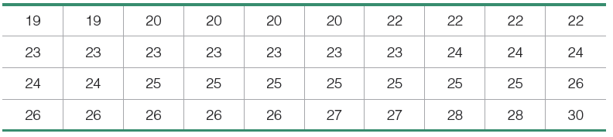
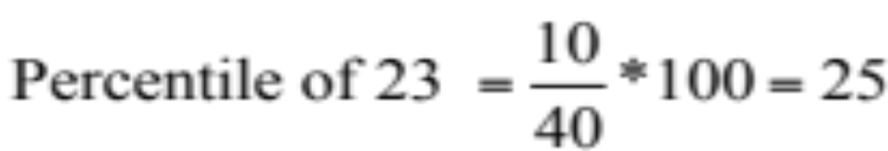
Example
For the 40 Chips Ahoy cookies, find the percentile for a cookie with 23 chips.
Answer: We see there are 10 cookies with fewer than 23 chips, so
A cookie with 23 chips is in the 25th percentile.

Slide 52
Quartiles
Are measures of location, denoted Q₁, Q₂, and Q₃, which divide a set of data into four groups with about 25% of the values in each group.
Q₁ (First quartile) separates the bottom 25% of sorted values from the top 75%.
Q₂ (Second quartile) same as the median; separates the bottom 50% of sorted values from the top 50%.
Q₃ (Third quartile) separates the bottom 75% of sorted values from the top 25%.

Slide 53
Quartiles
Q₁, Q₂, Q₃
divide sorted data values into four equal parts
25%
25%
25%
25%
Q₁
Q₂
Q₃
(minimum)
(maximum)
(median)

Slide 54

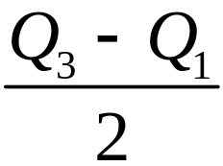
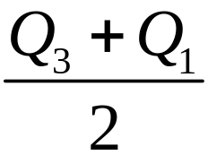
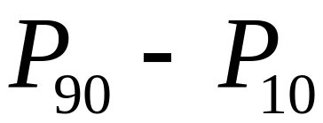
Other Statistics
Interquartile Range (or IQR):
Semi-interquartile Range:
Midquartile:
10 - 90 Percentile Range:

Slide 55
Box-Plots
A way to graphically portray almost all the descriptive statistics at once is the box-plot.
A box-plot shows: Upper and lower quartiles
Mean
Median
Range
Outliers (1.5 IQR)

Slide 56
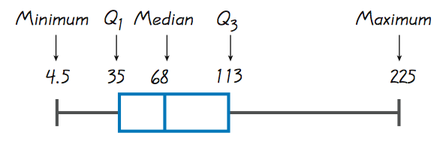
Boxplots

Slide 57
Hypothesis

Slide 58
In this session ….
What is hypothesis testing?
Interpreting and selecting significance level
Type I and Type II errors
One tailed and two tailed tests

Slide 59
What is Hypothesis Testing?
Hypothesis testing refers to
Making an assumption, called hypothesis, about a population parameter.
Collecting sample data.
Calculating a sample statistic.
Using the sample statistic to evaluate the hypothesis (how likely is it that our hypothesized parameter is correct. To test the validity of our assumption we determine the difference between the hypothesized parameter value and the sample value.)

Slide 60
HYPOTHESIS TESTING
Null hypothesis, H₀
Alternative hypothesis,H_{A}
State the hypothesized value of the parameter before sampling.
The assumption we wish to test (or the assumption we are trying to reject)
E.g population mean µ = 20
There is no difference between coke and diet coke
All possible alternatives other than the null hypothesis.
E.g µ ≠ 20
µ > 20
µ < 20
There is a difference between coke and diet coke

Slide 61
Null Hypothesis
The null hypothesis H₀ represents a theory that has been put forward either because it is believed to be true or because it is used as a basis for an argument and has not been proven.
For example, in a clinical trial of a new drug, the null hypothesis might be that the new drug is no better, on average, than the current drug.
We would write
H₀: there is no difference between the two drugs on an average.
- the B-school

Slide 62
Alternative Hypothesis
  The alternative hypothesis, H_{A}, is a statement of what a statistical hypothesis test is set up to establish.
  For example, in the clinical trial of a new drug, the alternative hypothesis might be that the new drug has a different effect, on average, compared to that of the current drug.
  We would write
  H_{A}: the two drugs have different effects, on average.
  or
  H_{A}: the new drug is better than the current drug, on average.
  The result of a hypothesis test:
  ‘Reject H₀ in favour of H_{A}’ OR ‘Do not reject H₀’

Slide 63
Selecting and interpreting significance level
Deciding on a criterion for accepting or rejecting the null hypothesis.
Significance level refers to the percentage of sample means that is outside certain prescribed limits. E.g testing a hypothesis at 5% level of significance means
that we reject the null hypothesis if it falls in the two regions of area 0.025.
Do not reject the null hypothesis if it falls within the region of area 0.95.
The higher the level of significance, the higher is the probability of rejecting the null hypothesis when it is true.
(acceptance region narrows)

Slide 64
Type I and Type II Errors
Type I error refers to the situation when we reject the null hypothesis when it is true (H₀ is wrongly rejected).
e.g H₀: there is no difference between the two drugs on average.
Type I error will occur if we conclude that the two drugs produce different effects when actually there isn’t a difference.
2. Type II error refers to the situation when we accept the null hypothesis when it is false.
H₀: there is no difference between the two drugs on average.
Type II error will occur if we conclude that the two drugs produce the same effect when actually there is a difference.

Slide 65
Type I and Type II Errors – Example
Your null hypothesis is that the battery for a heart pacemaker has an average life of 300 days, with the alternative hypothesis that the average life is more than 300 days. You are the quality control manager for the battery manufacturer.
Would you rather make a Type I error or a Type II error?
Based on your answer to part (a), should you use a high or low significance level?

Slide 66
Type I and Type II Errors – Example
Given H₀ : average life of pacemaker = 300 days, and H_{A}: Average life of pacemaker > 300 days
It is better to make a Type II error (where H₀ is false i.e average life is actually more than 300 days but we accept H₀ and assume that the average life is equal to 300 days)
As we increase the significance level (α) we increase the chances of making a type I error. Since here it is better to make a type II error we shall choose a low α.

Slide 67
Two Tail Test
Two tailed test will reject the null hypothesis if the sample mean is significantly higher or lower than the hypothesized mean.
Appropriate when H₀ : µ = µ₀ and H_{A}: µ ≠ µ₀
e.g The manufacturer of light bulbs wants to produce light bulbs with a mean life of 1000 hours. If the lifetime is shorter he will lose customers to the competition and if it is longer then he will incur a high cost of production. He does not want to deviate significantly from 1000 hours in either direction.
Thus he selects the hypotheses as
H₀ : µ = 1000 hours and H_{A}: µ ≠ 1000 hours
and uses a two tail test.

Slide 68
One Tail Test
A one-sided test is a statistical hypothesis test in which the values for which we can reject the null hypothesis, H₀ are located entirely in one tail of the probability distribution.
Lower tailed test will reject the null hypothesis if the sample mean is significantly lower than the hypothesized mean.
Appropriate when H₀ : µ = µ₀ and H_{A}: µ < µ₀
e.g A wholesaler buys light bulbs from the manufacturer in large lots and decides not to accept a lot unless the mean life is at least 1000 hours.
H₀ : µ = 1000 hours and H_{A}: µ <1000 hours
and uses a lower tail test.
i.e he rejects H₀ only if the mean life of sampled bulbs is significantly below 1000 hours. (he accepts H_{A} and rejects the lot)

Slide 69
One Tail Test
Upper tailed test will reject the null hypothesis if the sample mean is significantly higher than the hypothesized mean.
Appropriate when H₀ : µ = µ₀ and H_{A}: µ > µ₀
e.g A highway safety engineer decides to test the load bearing capacity of a 20 year old bridge. The minimum load-bearing capacity of the bridge must be at least 10 tons.
H₀ : µ = 10 tons and H_{A}: µ >10 tons
and uses an upper tail test.
i.e he rejects H₀ only if the mean load bearing capacity of the bridge is significantly higher than 10 tons.

Slide 70
THE END

